Slide 1

Department of Computer Science and Engineering
Diabetic Retinopathy Detection
Date: 19 April 2021
Vunnam Neha Chowdary : 17wh1a0594
Jangampally Nikitha : 17wh1a05a1
Surannagari Shirisha : 18wh5a0518
Internal Guide: Mr.M Dyva Sugnana Rao
Designation : Assistant Professor

Slide 2

Abstract
Why Should I Study this course?
Diabetic retinopathy (DR) is an eye disease caused by the complication of diabetes and we should detect it early for effective treatment. As diabetes progresses, the vision of a patient may start to deteriorate and lead to diabetic retinopathy. First we pre-process the image to enhance the required features for the ML techniques to work. Next, we extract features using Gabor filters and feed into our ML algorithms.
Examples
BVRIT HYDERABAD College of Engineering for Women

Slide 3
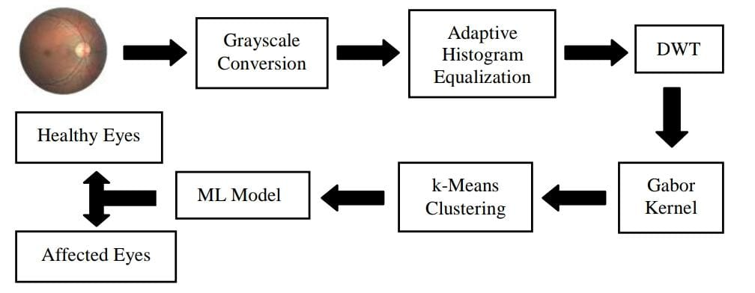
Block Diagram
Why Should I Study this course?
Examples
Fig. 1. Block Diagram of Proposed System
BVRIT HYDERABAD College of Engineering for Women

Slide 4
Dataset
Dataset Name : DIARETDB1
Total Images : 89
Source : https://www.it.lut.fi/project/imageret/diaretdb1/

Slide 5
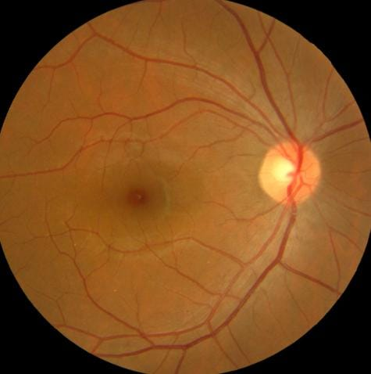
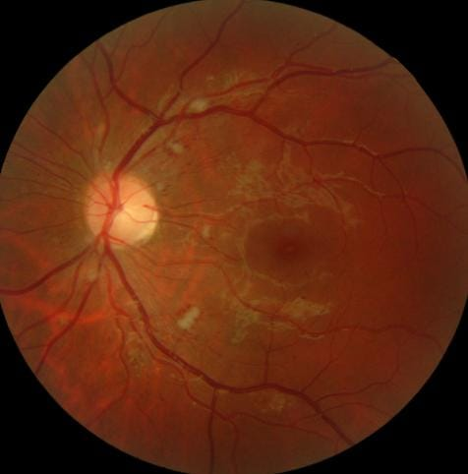
Sample Images
Fig. 3. Healthy Retinal Fundus Fig. 4. Retinal Fundus with DR

Slide 6
Technology Stack
Why Should I Study this course?
Domain : Machine Learning
Programming Language : Python
Libraries Needed:
sklearn
pywt
skimage
cv2
matplotlib
numpy
Examples
BVRIT HYDERABAD College of Engineering for Women

Slide 7
References
Why Should I Study this course?
Diabetic Retinopathy Detection Using Machine Learning and Texture Features Mohamed Chetoui, Moulay A. Akhloufi, Mustapha Kardouchi Perception, Robotics, and Intelligent Machines Research Group (PRIME), Dept. of Computer Science, Université de Moncton Moncton, NB, Canada (IEEE Canadian Conference on Electrical & Computer Engineering (CCECE) - 2018) – BASE PAPER
S. Mohammadian, A. Karsaz and Y. M. Roshan, "A comparative analysis of classification algorithms in diabetic retinopathy screening," 2017 7th International Conference on Computer and Knowledge Engineering (ICCKE), Mashhad, pp. 84-89, 2017.
M. N. Ashraf, Z. Habib and M. Hussain, "Texture Feature Analysis of Digital Fundus Images for Early Detection of Diabetic Retinopathy," 2014 11th International Conference on Computer Graphics, Imaging and Visualization, Singapore, pp. 57-62, 2014.
M. Tavakoli, R. Shahri, H. Pourreza, A. Mehdizadeh, T. Banaee and M. Bahreini Toosi, "A complementary method for automated detection of microaneurysms in fluorescein angiography fundus images to assess diabetic retinopathy," Pattern Recognition, vol. 46, no. 10, pp. 2740- 2753, 2013.
Examples
BVRIT HYDERABAD College of Engineering for Women

Slide 8
Thankyou

